Slide 1
Analyzing Indicators of Kickstarter Project success
Ryan French, Saurabh Gupta, Vedika Shenoy

Slide 2
Introduction to kickstarter
Kickstarter is an American public-benefit corporation based in Brooklyn, NY
Launched on April 28, 2009 by Perry Chen, Yancey Strickler, and Charles Adler
It maintains a global crowdsourcing platform focused on creativity and merchandising
Motive is to “help bring creative projects to life”

Slide 3
PROBLEM
What factors are important to a successful Kickstarter campaign?

Slide 4
EXPECTED Outcomes
Discover associations between various factors (such as, starting goal) and funding of projects
Build classifiers predicting the success of new projects
Determine which projects are frequently funded

Slide 5
DATA DESCRIPTION
Data Source: https://www.kaggle.com/kemical/kickstarter-projects
Variables:
ID – Internal Kickstarter ID (string)
Name – Name of the project (string)
Category – sub-category of project (string)
Main Category – Primary category (string)
Currency – Currency used to support the project (string)
Deadline – Deadline date for crowd funding (date)
Goal – Fundraising Goal (float)
Launched – Date of project’s launch (date)
Pledged – Amount pledged by supporters (float)
State – Current condition of the project (string)
Backers – Numbers of backers (integer)
Country – Country of origin (string)
USD pledged – Amount of money pledged (float)

Slide 6
Evaluation Method
The following steps were performed in order to fulfill our goal:
Data cleaning and preparing data for analysis
Association rules formation
Logistic Regression, Naïve Bayes and Random Forest modeling for prediction

Slide 7
Handling missing values
Removed empty columns
Dropped rows with invalid main category
Dropped rows with invalid currency
Removed projects with a state of ‘undefined’
Update invalid ‘country’ or ‘name’ values to ‘none’
Convert invalid dates to '1990-01-01 01:00:00’

Slide 8
Handling missing values Continued
Split datetime columns into year and month
Dropped old datetime columns
Removed entries with strings in 'backers’
Removed entries with strings in ‘usd pledged’
Engineered dummy variable to indicate project success
After the data cleaning, we were left with 374373 rows (of 378648 rows originally), 98.8% of the initial dataset

Slide 9
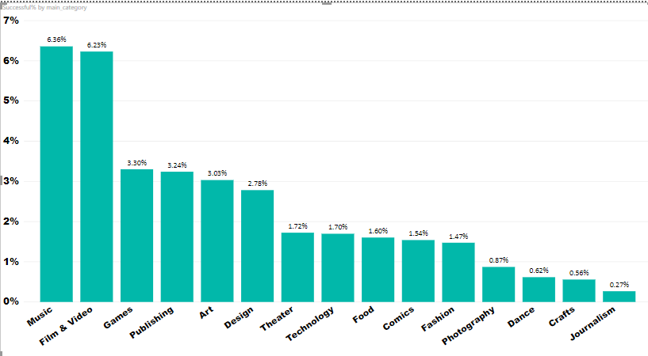
Initial descriptive analysis
Percentage of Successful Projects By Main Category

Slide 10
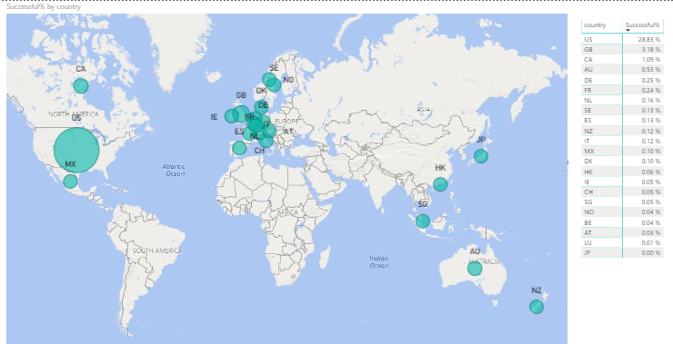
Percentage of Successful Projects By Country

Slide 11
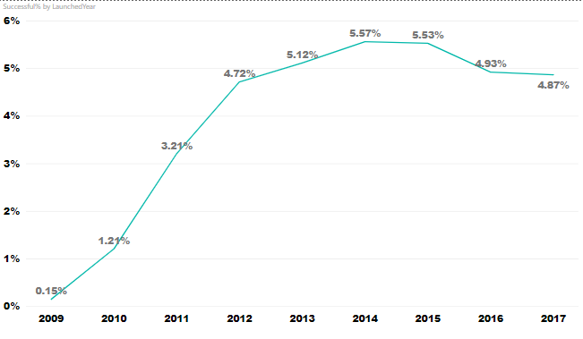
Percentage of Successful Projects By Launched Year

Slide 12
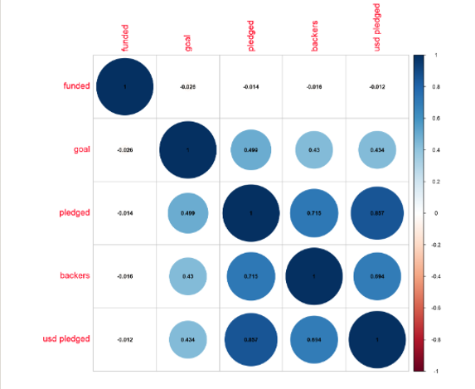
Correlation Matrix between funded (and successful) projects and other variables

Slide 13
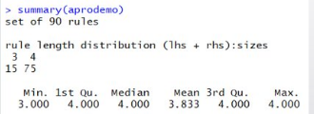
TECHNICAL SOLUTION
​ASSOCIATION RULE MINING
​
SUPPORT = 0.01​
CONFIDENCE = 0.7​
RULES GENERATED = 90​
​
​

Slide 14
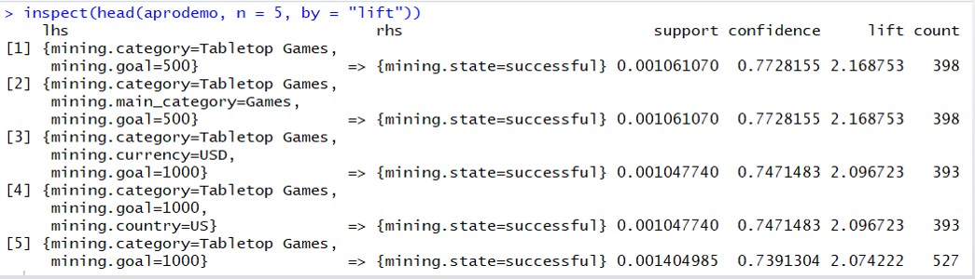
Top 5 Rules from Association Rule Mining:

Slide 15
Important Factors for Success of Kick Starter Projects as determined by Association Rule Mining:
Attribute | Value
Main Category | Games, Theater, Dance
Sub Category | Tabletop games, Indie Rock
Goal | 500 – 1000 for Games, 1000 – 3000 for Theater
Launch Year | 1970 – 2014 for Indie Rock and Dance, 2015 – 2018 for Theater
Country | US for Theater, Games and Dance, GB for Theater

Slide 16
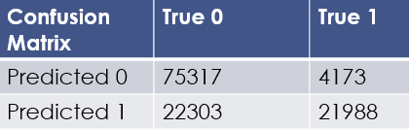
LOGISTIC REGRESSION MODEL
Split: 2 to 1 (train to test)​
Accuracy: 78.6%​
Precision: 84.0%​
Recall: 49.6%
​
​

Slide 17
​NAÏVE BAYES MODEL
​
Split: 2 to 1 (train to test)​
​
Independent Variables:​
Category, Main Category, Country, Currency, Goal, Pledged, Backers, USDPledged, Deadline Year, Deadline month, Launched Month​
​
Accuracy: 85.24%
​
​
Confusion Matrix | True 0 | True 1
Predicted 0 | 68950 | 7170
Predicted 1 | 11237 | 37356

Slide 18
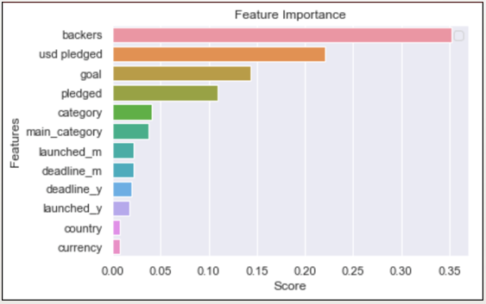
RANDOM FOREST MODEL
Initial Random
Forest:
1000 trees​
Results​
Accuracy: 93.4%​
Precision: 90.7%​
Recall: 90.8%
​
​
Refined Random Forest:​
1000 trees​
Results​
Accuracy: 96.1%​
Precision: 94.4%​
Recall: 94.7%

Slide 19
MODELS’ COMPARISON
MODEL NAME | ACCURACY
LOGISTIC REGRESSION | 78.6%
NAÏVE BAYES | 85.2%
RANDOM FOREST | 96.1%

Slide 20
CHALLENGES ENCOUNTERED
1) SVM model taking a lot of time to processing and keeps on crashing​
​
2) Overfitting of data in Naïve Bayes – solved by disregarding launched and deadline days, state columns ​
​

Slide 21
BUSINESS RECOMMENDATIONS
Setting goals between $1000 to $3000 for Theater will contribute to project success
Launching projects in the categories Dance, Games and Theatre tends to result in higher success rates
In Gaming category, launching projects related to Tabletop Games will lead to higher chances of project success
Setting a goal of $500 to $1000 for Games will contribute to project success
Launching projects of Theatre category will be successful in US as well as GB especially when launched between May to August
​
​

Slide 22
Thank You!

